Slide 1


Slide 2
ENGINEERS’ DAY CEREMONY • 2026
DEPARTMENT OF COMPUTER SCIENCE & ENGINEERING
DIGITAL
Aadhaar
UPI
INDIA
DIGITAL
INDIA
Engineering a Connected, Inclusive
& Digital Nation
DigiLocker
PMGDISHA
CSE / B.Tech • Section B
Chandra (261072) • Nishant (261061)
Hari (261071) • Kanhaiya (261068)
Guidance • Mrs. Aastha Kashyap, Assistant Professor, Dept. CSE

Slide 3
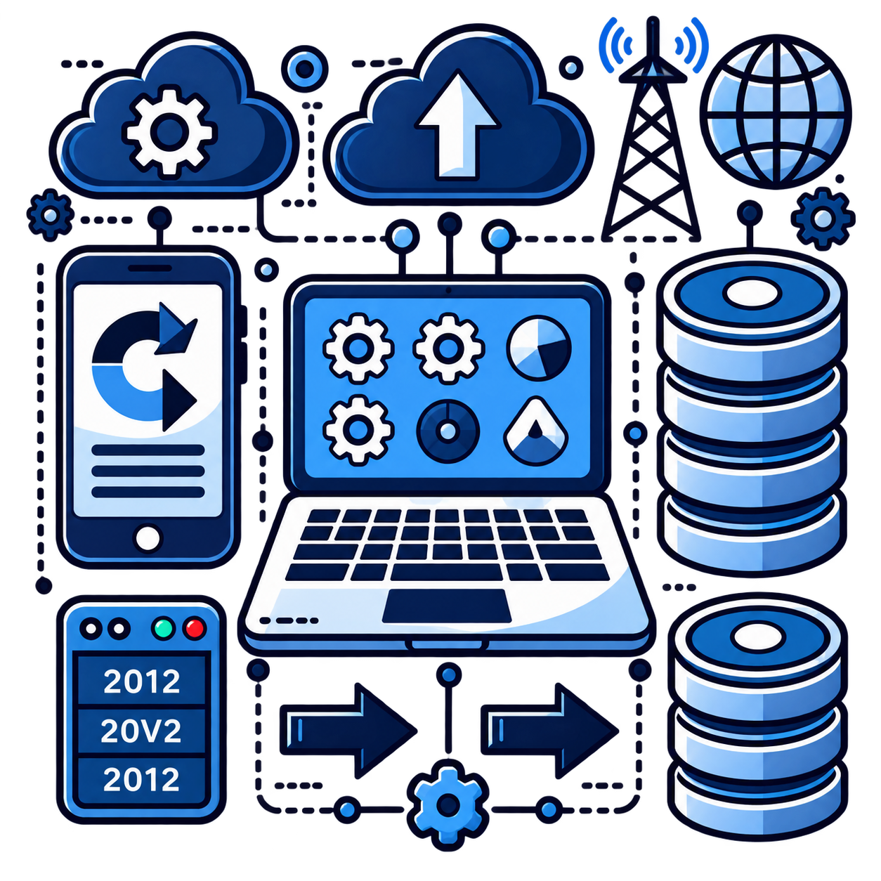

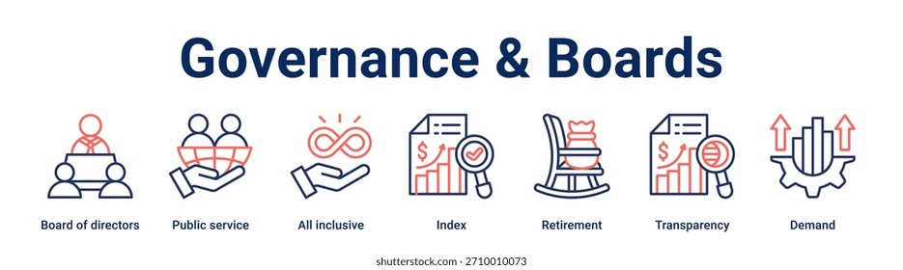
What is Digital India?
A national programme to digitally empower society and build a knowledge economy.
Digital Infrastructure
Governance on Demand
Digital Empowerment
Citizens equipped with digital access, documents, skills and services.
Digital identity, connectivity and trusted platforms as core public infrastructure.
Government services designed to be accessible, efficient and available digitally.
Digital India • Engineers’ Day Ceremony 2026 | 2/10

Slide 4
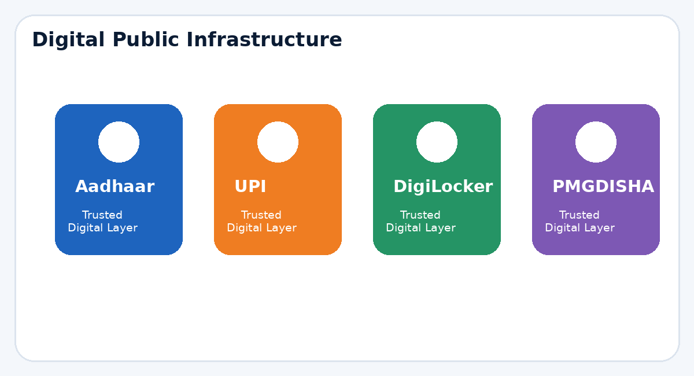
India’s Digital Public Infrastructure
Four examples connecting identity, payments, documents and inclusion.
Aadhaar
DigiLocker
Digital identity at population scale.
Secure digital documents and verification.
UPI
PMGDISHA
Instant, interoperable digital payments.
Digital literacy and inclusion.
Trusted digital layers that work together at national scale.
Digital India • Engineers’ Day Ceremony 2026 | 3/10

Slide 5
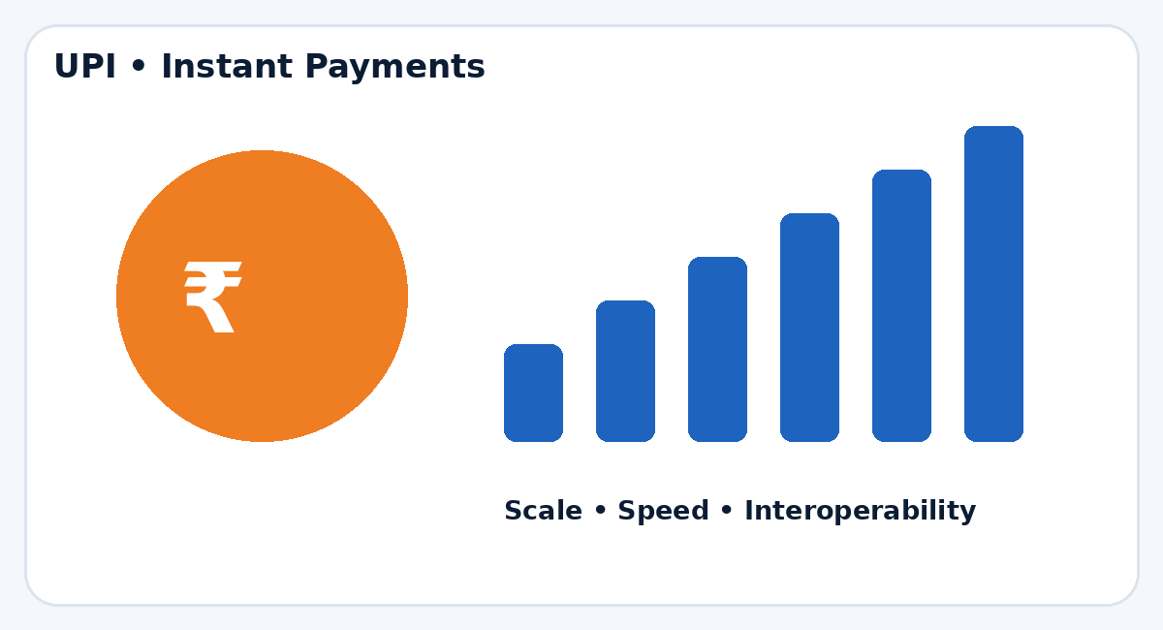
UPI: Digital Payments at Massive Scale
NPCI product statistics • August 2026
24.51 BILLION
₹29.82 TRILLION
752 BANKS
UPI transactions
Transaction value
Live on UPI
UPI transaction volume (Apr–Aug 2026, billion)
24.51
23.66
23.20
22.35
22.72
Apr
May
Jun
Jul
Aug
Source: NPCI UPI Product Statistics
Digital India • Engineers’ Day Ceremony 2026 | 4/10

Slide 6
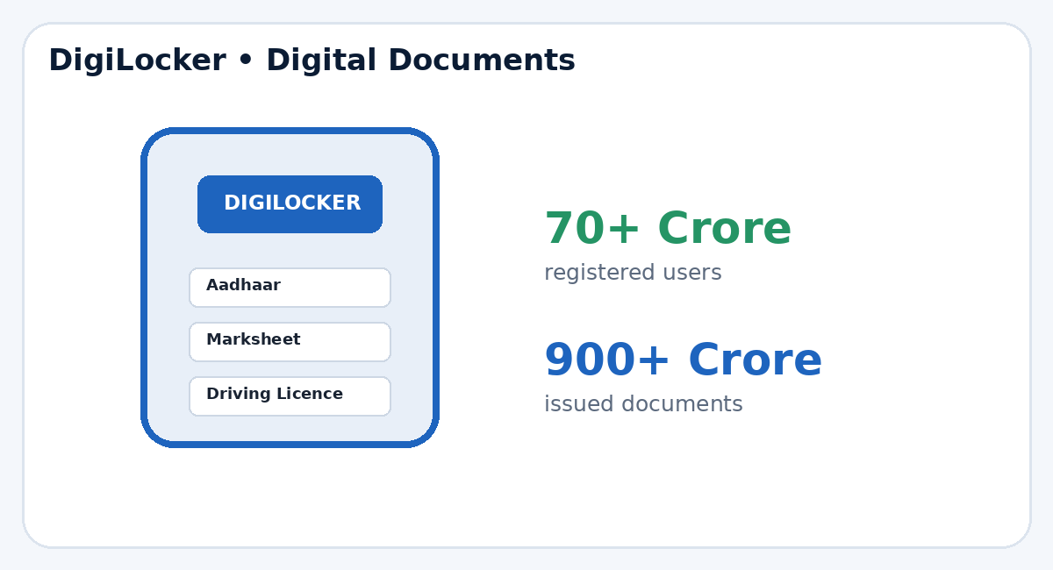
DigiLocker: Documents in Your Pocket
Official DigiLocker portal • August 2026
70+ CRORE
900+ CRORE
Registered users
Documents issued
Why it matters
Secure storage • easy sharing & verification • less dependence on physical documents • trusted digital service delivery
Digital India • Engineers’ Day Ceremony 2026 | 5/10

Slide 7
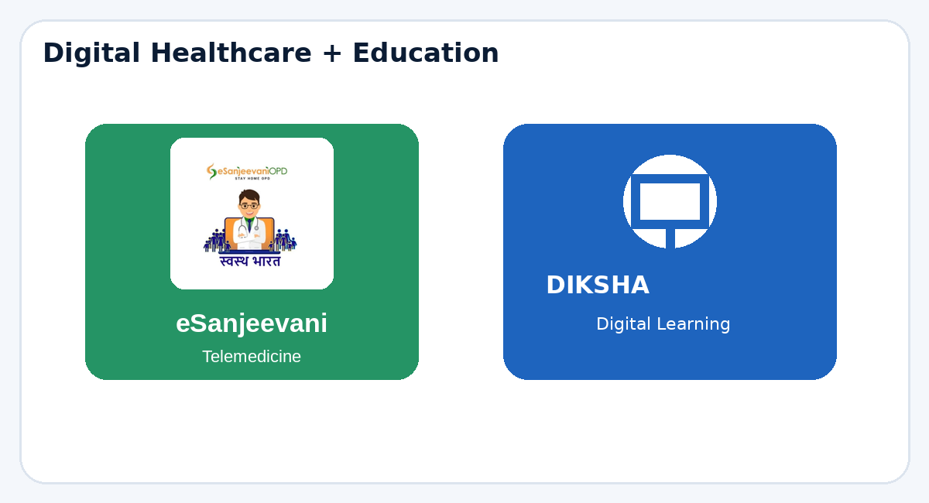
Digital India in Healthcare & Education
Digital platforms extend access beyond physical locations.
eSanjeevani
DIKSHA
India’s national telemedicine service.
Over 330 million patients had been served by 31 Dec 2024, according to the MoHFW Annual Report 2024–25.
Digital learning platform supporting teachers, students, parents and school officials.
Supports regional-language learning, online/offline access and digital certificates.
Digital India • Engineers’ Day Ceremony 2026 | 6/10

Slide 8
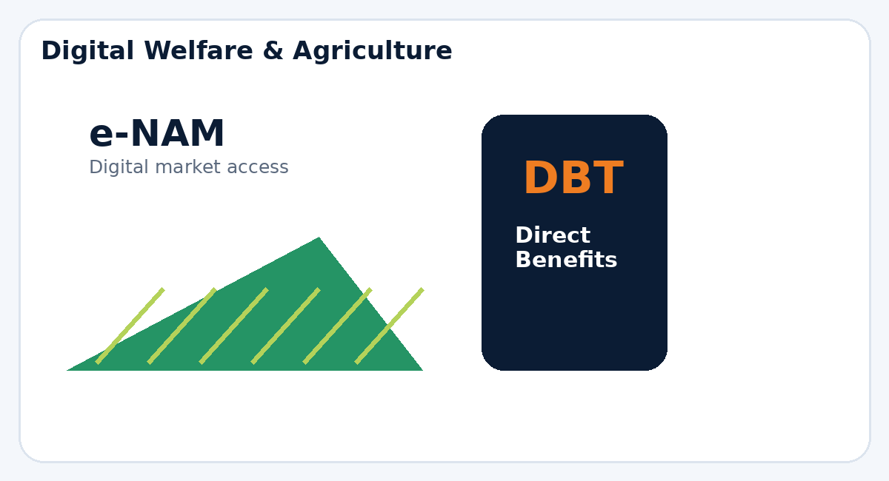
Agriculture, Welfare & Direct Benefits
Digital systems can improve reach, transparency and access.
DBT
e-NAM
Direct Benefit Transfer helps route eligible government benefits directly to beneficiaries.
Digital agricultural marketplace supporting wider market access and transparent price discovery.
The engineering challenge is not only building platforms—it is making them reliable and usable at national scale.
Digital India • Engineers’ Day Ceremony 2026 | 7/10

Slide 9
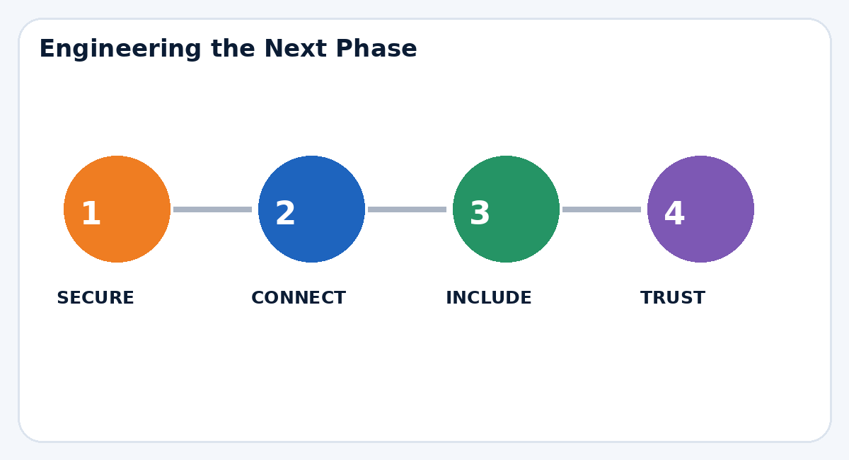
The Engineering Road Ahead
From digital adoption to trusted, inclusive systems.
01 • SECURITY
02 • CONNECT
Build privacy, resilience and cybersecurity in from day one.
Expand dependable digital infrastructure beyond major urban centres.
03 • MULTILINGUAL AI
04 • TRUST
Make digital services easier to use across India’s languages.
Transparent data practices are essential for long-term adoption.
Digital India’s next phase is about engineering TRUST at scale.
Digital India • Engineers’ Day Ceremony 2026 | 9/10

Slide 10
CONCLUSION
Digital India: From Technology to Transformation
Digital India has shown how engineering can turn digital infrastructure into everyday public value.
ACCESS
TRUST
INCLUSION
SCALE
Bring services closer to every citizen.
Build secure, privacy-conscious systems.
Design for languages, skills and the last mile.
Engineer platforms that remain reliable at national scale.
The next phase is not only digital — it must be TRUSTED, INCLUSIVE & HUMAN-CENTRIC.
Thank You
Guidance: Mrs. Aastha Kashyap • Assistant Professor, Dept. CSE

Slide 11


